Slide 1
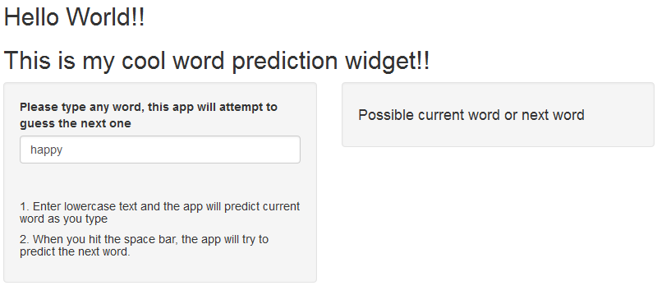
3. Suggestions words will appear here
2. As you are typing current word, the app suggests the completion to current word
When you type in the <Space> key, the app knows you would like to start a
new word so it is kind enough to suggests one.
1. Type lowercase words

